Slide 1



SRI RAMAKRISHNA ENGINEERING COLLEGE
[Educational Service : SNR Sons Charitable Trust]
[Autonomous Institution, Accredited by NAAC with ‘A’ Grade]
[Approved by AICTE and Permanently Affiliated to Anna University, Chennai]
[ISO 9001-2008 Certified and all eligible programs Accredited by NBA]
VATTAMALAIPALAYAM, N.G.G.O. COLONY POST, COIMBATORE – 641 022.
DEPARTMENT OF ELECTRICAL AND ELECTRONICS ENGINEERING
Intelligent Irrigation System
(IoT)
By
Ranjit V S
15/03/2018
01

Slide 2
Abstract
Intelligent irrigation system is cost-effective IoT based low power consumption device connected with cloud to irrigate water to the agriculture field during both day and night depending upon the type of crops and the size of the plant. The environmental climatic condition, amount of water flow, the present status of the motor pumps can be monitored in a dashboard, the above parameters can be recorded in cloud for a number of months to analyze the wastage of water and to analyze the climatic condition of the environment to plant proper crops in a correct season to reduce the water loss and to monitor the irrigation system through a live camera in the field integrating it with image processing. The main controller is connected to a server through MQTT protocol to monitor and control the intelligent irrigation system from any part of the world via mobile app and by Short Message Service using a mobile phone, tablet and PC. The main controller also can be connected to the wireless remote with operating range of 10Km. Its is connected with a lithium ion battery that can be recharged by a solar power. The Smart irrigation system can take correct decision by its own in case of any emergency and it can send an alert message to the formers.
15/03/2018
02

Slide 3
Factors to be considered during irrigation
03
Size of plant
Small or Large
02
Type of plant
What type of plant is it
01
Environmental Climate
Temperature and Humidity
15/03/2018
03

Slide 4



Sensor Monitoring
Temperature
Humidity
DHT 22 sensor is used to sense temperature.
DHT 22 sensor is used to sense humidity.
Pump Status
Water flow
The present status of the pump can be monitored.
Flow meter sensor is used to measure the water flow.
Power consumption
Soil Moisture
The power consumed by the pump will be remotely monitored by sub energy meter
Moisture sensor is used to sense the moisture.
15/03/2018
04

Slide 5
Device Features
Alert notification message.
04
Low maintenance charge.
02
Highly secured device.
03
01
Remote access.
15/03/2018
05

Slide 6
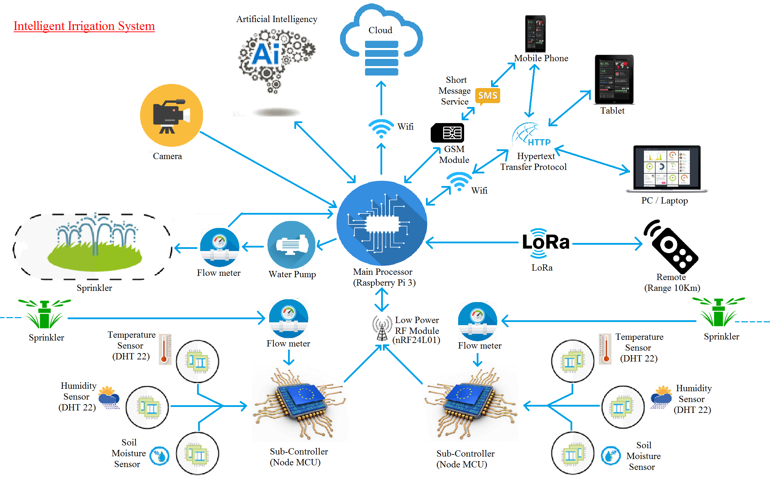
Block Diagram
15/03/2018
06

Slide 7
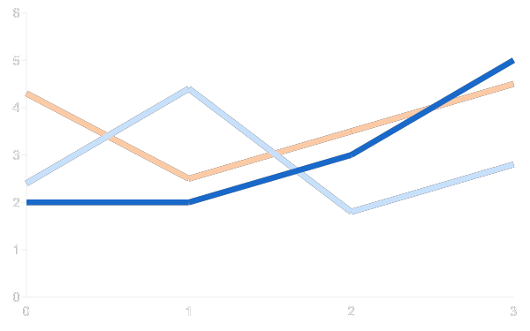



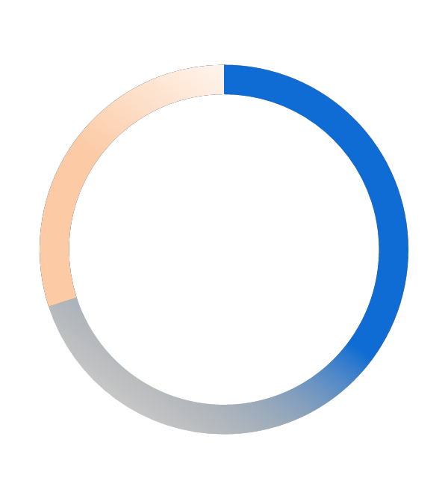
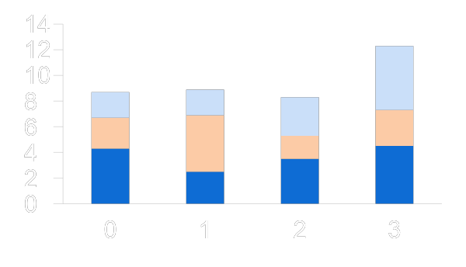
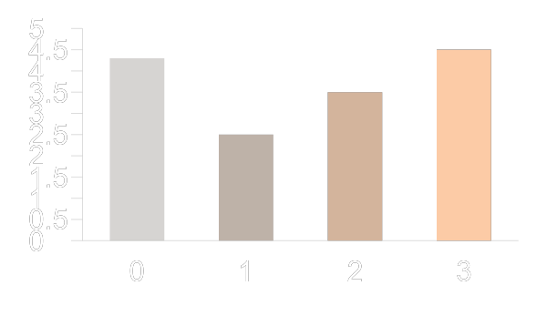
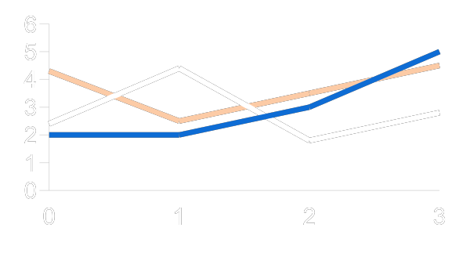
Cloud Monitoring
Temperature (In *C)
Humidity
Voltage
Current
440/450
10/15
0
450
0
15
680/10000 KW/hr
Soil Moisture
Water Flow (In Litters)
Power
430/440 Volts
Voltage
10/15 Amps
Current
Power Factor
Water Efficiency
Sub-Controller Battery Charge
Power Consumption (Per Month)
70%
15/03/2018
07

Slide 8





Remote devices used to control irrigation system
01
PC
02
Laptop
The Intelligent Irrigation System can be monitored and controlled by web server.
The Intelligent Irrigation System can be monitored and controlled by web server.
05
Remote
The Intelligent Irrigation System can be monitored and controlled by a wireless remote with working range of 10Km.
03
Smart Phone
04
Tablet
The Intelligent Irrigation System can be monitored and controlled by web server and a mobile application.
The Intelligent Irrigation System can be monitored and controlled by web server and a mobile application.
15/03/2018
08

Slide 9
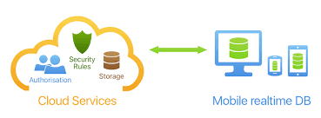
Cayenne IoT Cloud Service
Cayenne is a Open source IoT platform Works with MQTT protocol.
15/03/2018
09

Slide 10
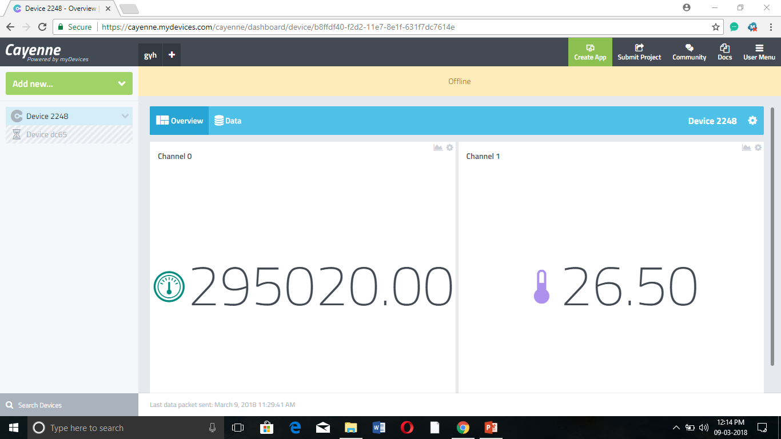
Cayenne Realtime Database
15/03/2018
10

Slide 11
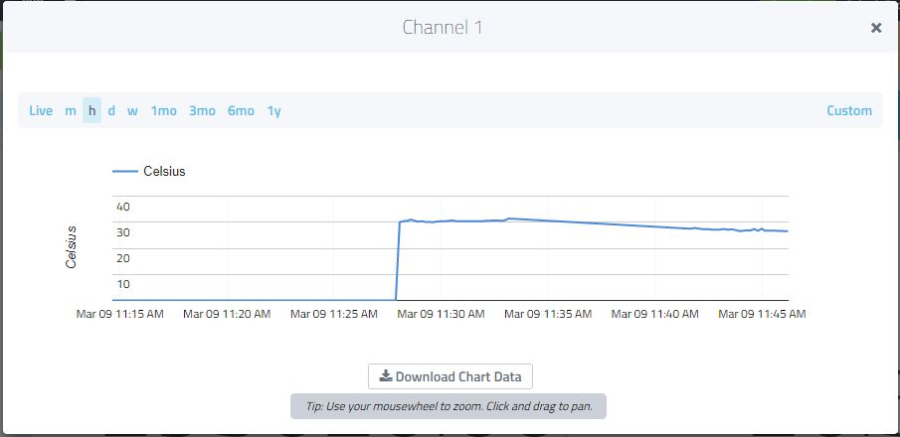
Database Analysis in Graph
15/03/2018
11

Slide 12
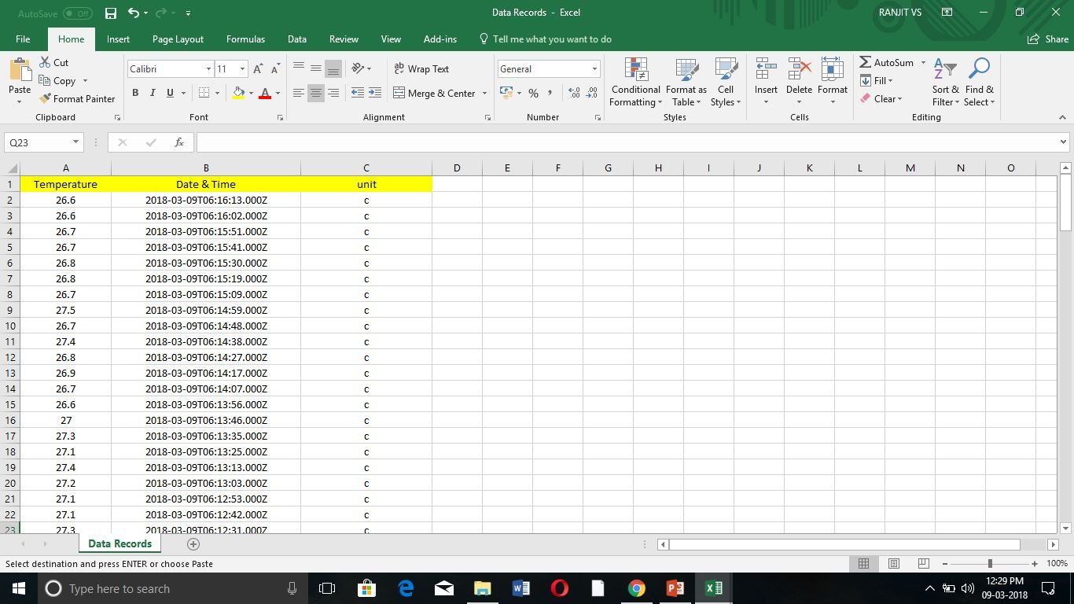
Database Analysis in Spread Sheet
15/03/2018
12

Slide 13


Advanced features involved in device
Continuous monitoring.
Long range wireless connectivity.
Automatic decision making.
Stores the amount of water, climatic contrition and electric power consumption in cloud.
Rechargeable long life battery for sub controller’s with renewable resource.
Reduces the monthly electricity bill charges.
15/03/2018
13

Slide 14



Communication Network Involved
Wifi
Wifi
Wifi is used to connect the main controller to the internet.
GSM
GSM
GSM is used to send and receive message from main controller to the mobile and tablet.
Radio Frequency
RF
RF is used by the main controller to communicate with the sub controllers.
LoRa
LoRa
LoRa
LoRa is used for communication between remote and the main controller.
15/03/2018
14

Slide 15
Hardware Required
Node MCU
DHT22 Temperature and Humidity Sensor
GSM Module
Flow Meter Sensor
Moisture sensor
1-Channel 5V Relay Board
15/03/2018
15

Slide 16
Software Required
Embedded C
Cloud
Cayenne
15/03/2018
16

Slide 17
Advantages
Low maintenance cost.
Long range wireless remote.
Automatic decision making.
Live monitoring.
Stores the record in the cloud.
Device works with renewable energy.
15/03/2018
17

Slide 18
Thank You
15/03/2018
18

